Slide 1
Machine Learning Price Action
In financial markets
Brandon Chen
David Zou
Santiago Rosas
Tim Kipper
Notes:
Our team consists of Brandon, David, Santiago, and Tim.
We chose to run an API built from Polygon to extract VOHLC (Volume, Open, Close, High, Low) data for the crypto Bitcoin (BTC).
The data from Polygon is extracted and run through a Terras framework to use neural network computing to provide a statistical analysis of the stock.
The VOHLC data from the last date available is fed into Amazon Lambda to provide information to the Amazon Lex user who would be using a chat service / mobile app framework to purchase Apple stock.

Slide 2
Disclaimer
None of the information contained here constitutes an offer (or solicitation of an offer) to buy or sell any currency, product or financial instrument, to make any investment, or to participate in any particular trading strategy.
We do not take into account of your personal investment objectives, specific investment goals, specific needs or financial situation and makes no representation and assumes no liability to the accuracy or completeness of the information provided here. The information and publications are not intended to be and do not constitute financial advice, investment advice, trading advice or any other advice or recommendation of any sort offered or endorsed. We also does not warrant that such information and publications are accurate, up to date or applicable to the circumstances of any particular case
Any expression of opinion (which may be subject to change without notice) is personal to the author and the author makes no guarantee of any sort regarding accuracy or completeness of any information or analysis supplied.
We are not responsible for any loss arising from any investment based on any perceived recommendation, forecast or any other information contained here. The contents of these publications should not be construed as an express or implied promise, guarantee or implication by us that clients will profit or that losses in connection therewith can or will be limited, from reliance on any information set out here.

Slide 3


Purpose
To provide the end-user a brief review of relevant information regarding a particular financial instrument’s key information (POHL) prior to purchase
Price, Open, High, Low
Product is aimed towards beginner / intermediate users who want a simple, accessible interface
Act as an tool for trader to identify certain price patterns in the market using a quantitative approach via machine learning
To identity how certain price patterns performs historically
Notes:
Price, Open, High, Low, Volume, Change %

Slide 4
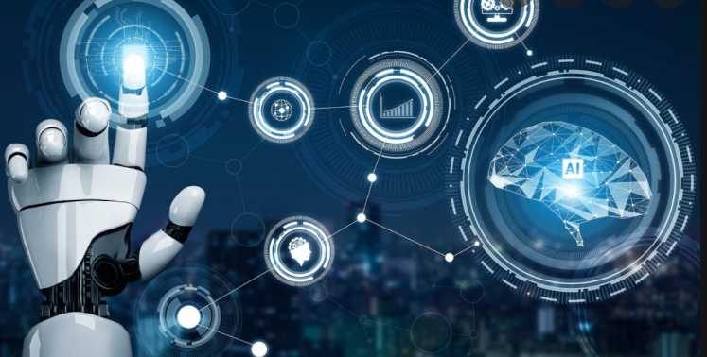
Technologies
Python
Jupyter Lab
Google Collab
Amazon Lambda
Amazon Lex

Slide 5
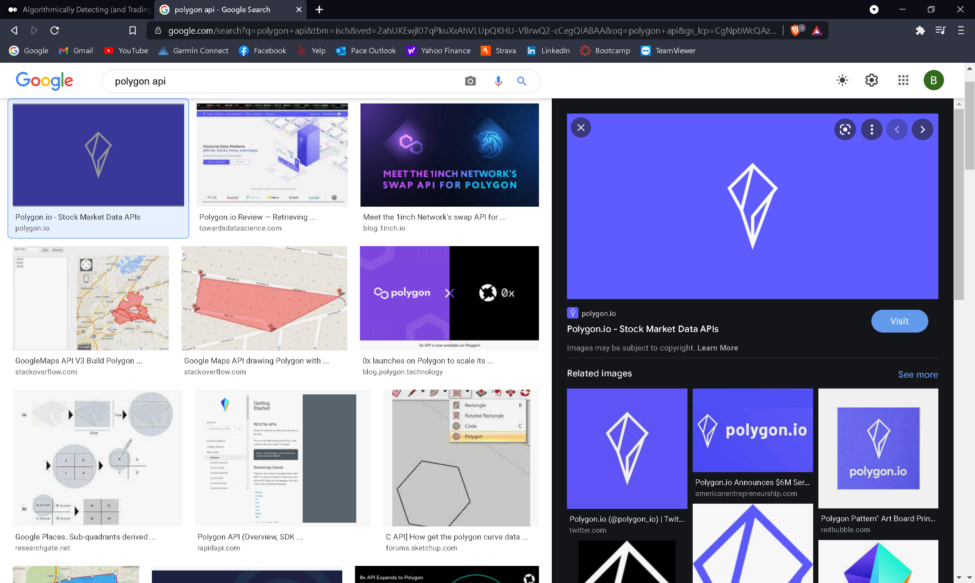
Data
Sourcing:
Polygon.io
Data type:
Data is extracted as Comma Separated Value (CSV)
Data Specs:
Bitcoin
Ticker : BTC
Range: 2017/01/01 ~ 2021/05/13
Time frame: 1 day
Clean up:
Data was collected from the range of January 2017 to May 2021 for BTC
Data was reconfigured into dataframes using Pandas
Columns: Time, Volume, Open, Close, High, Low, Percentage Change
Values for BTC were converted from string to int for ease of use / manipulation

Slide 6
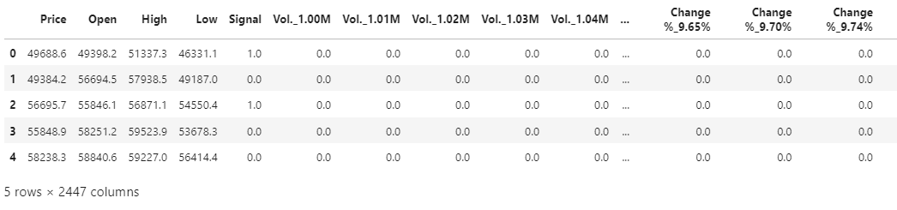
Setting Neural Network Model for BTC
Dropped irrelevant column (‘Time’) from Data Frame.
Added ‘Signal’ 0/1 based on Change Percent.
Used OneHotEncoder to encode the categorical variables.
Combined numerical variables and encoded variables into one Data Frame

Slide 7
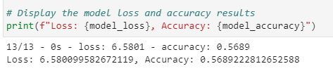
Building Neural Network Model for BTC
Set up X, y train and test data, and used StandardScaler to fit.
Defined number of inputs, hidden nodes for layers.
Added different activation ‘relu’, ‘selu’ and ‘linear’ as activation module.
Used 100 epochs to train the data.

Slide 8
Amazon Web Services - Lambda / Lex
Amazon Web Service chatbot user interface:
To import the most recent information regarding the investment’s key information
To serve as validation for the individual’s account
Provide some simple information for the investor to consider prior to authorizing purchase / sale

Slide 9

Conclusion
Based upon the statistical report created by our neural network model, there exists room for further improvement
Can an increase in accuracy, and lowering in loss, be achievable by means of culling unnecessary data fed into the model ?
Can the model be further improved upon by tying it to another asset of the same class or with more stability / predictability ?

Slide 10
Future Improvements
Based upon the framework created, we would like to expand the usability of the product to incorporate other financial instruments such as:
The ability to analyze the entire stock or ETF universe or various asset classes all at once
The ability to analyze and compare price patterns in different time frames ( ex. 15 min., 30min., 45 min. Daily)
The ability to identify various price patterns
Further develop chatbot user interface to provide more information / interactivity for the user (# of failstates for the security section, account recovery)
Include more options for user identification to assure account security

Slide 11
Resources and reference
https://polygon.io/docs/get_v2_aggs_ticker__stocksTicker__range__multiplier___timespan___from___to__anchor
https://github.com/PacktPublishing/Machine-Learning-for-Algorithmic-Trading-Second-Edition
https://github.com/ageron/handson-ml2
https://www.tensorflow.org/api_docs/python/tf/keras/activations

Slide 12
END

